Slide 1
AWS Elastic Load Balancing
SYS-360

Slide 2
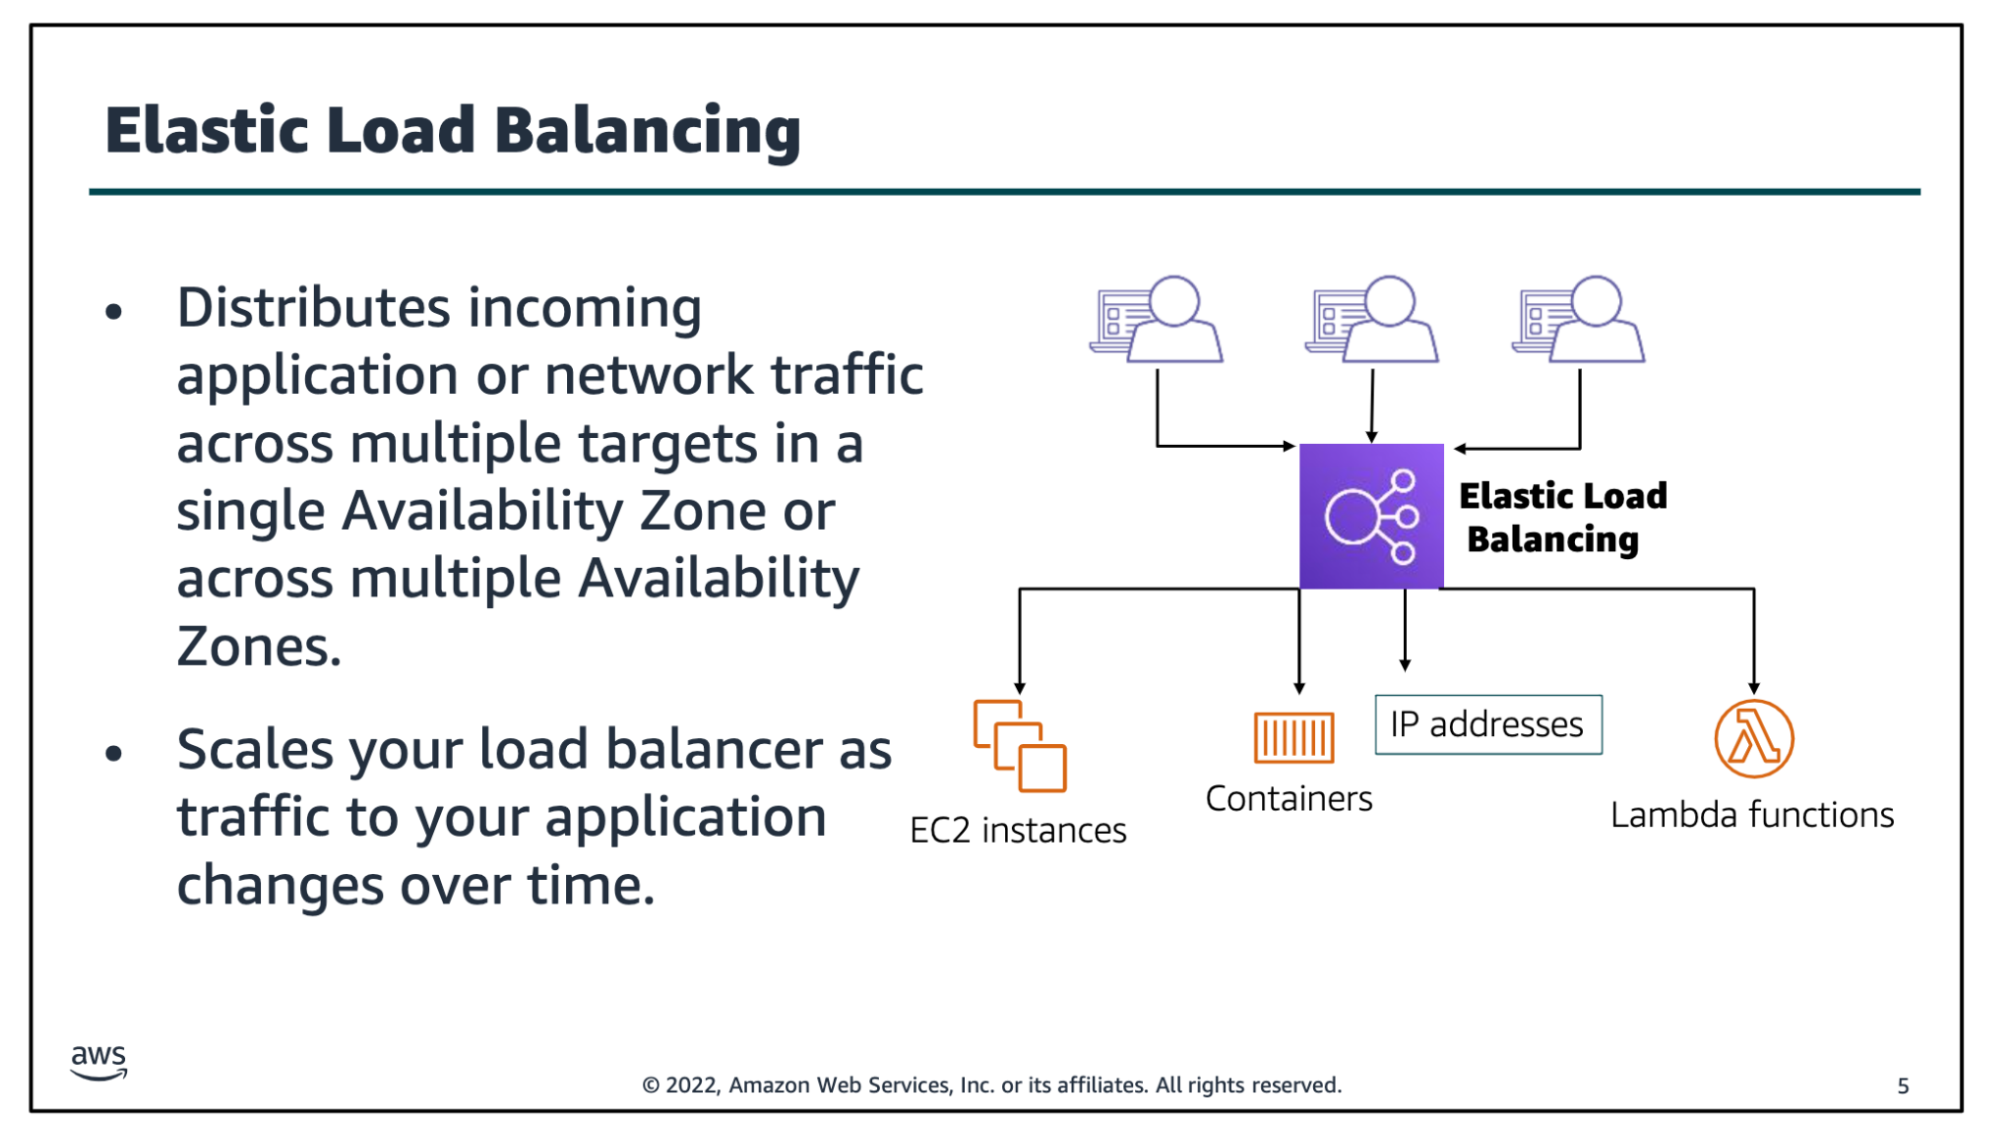
Notes:
Modern high-traffic websites must serve hundreds of thousands—if not millions—of concurrent requests from users or clients, and then return the correct text, images, video, or application data in a fast and reliable manner. Additional servers are generally required to meet these high volumes.Elastic Load Balancing is an AWS service that distributes incoming application or network traffic across multiple targets—such as Amazon Elastic Compute Cloud (Amazon EC2) instances, containers, internet protocol (IP) addresses, and Lambda functions—in a single Availability Zone or across multiple Availability Zones. Elastic Load Balancing scales your load balancer as traffic to your application changes over time. It can automatically scale to most workloads.

Slide 3
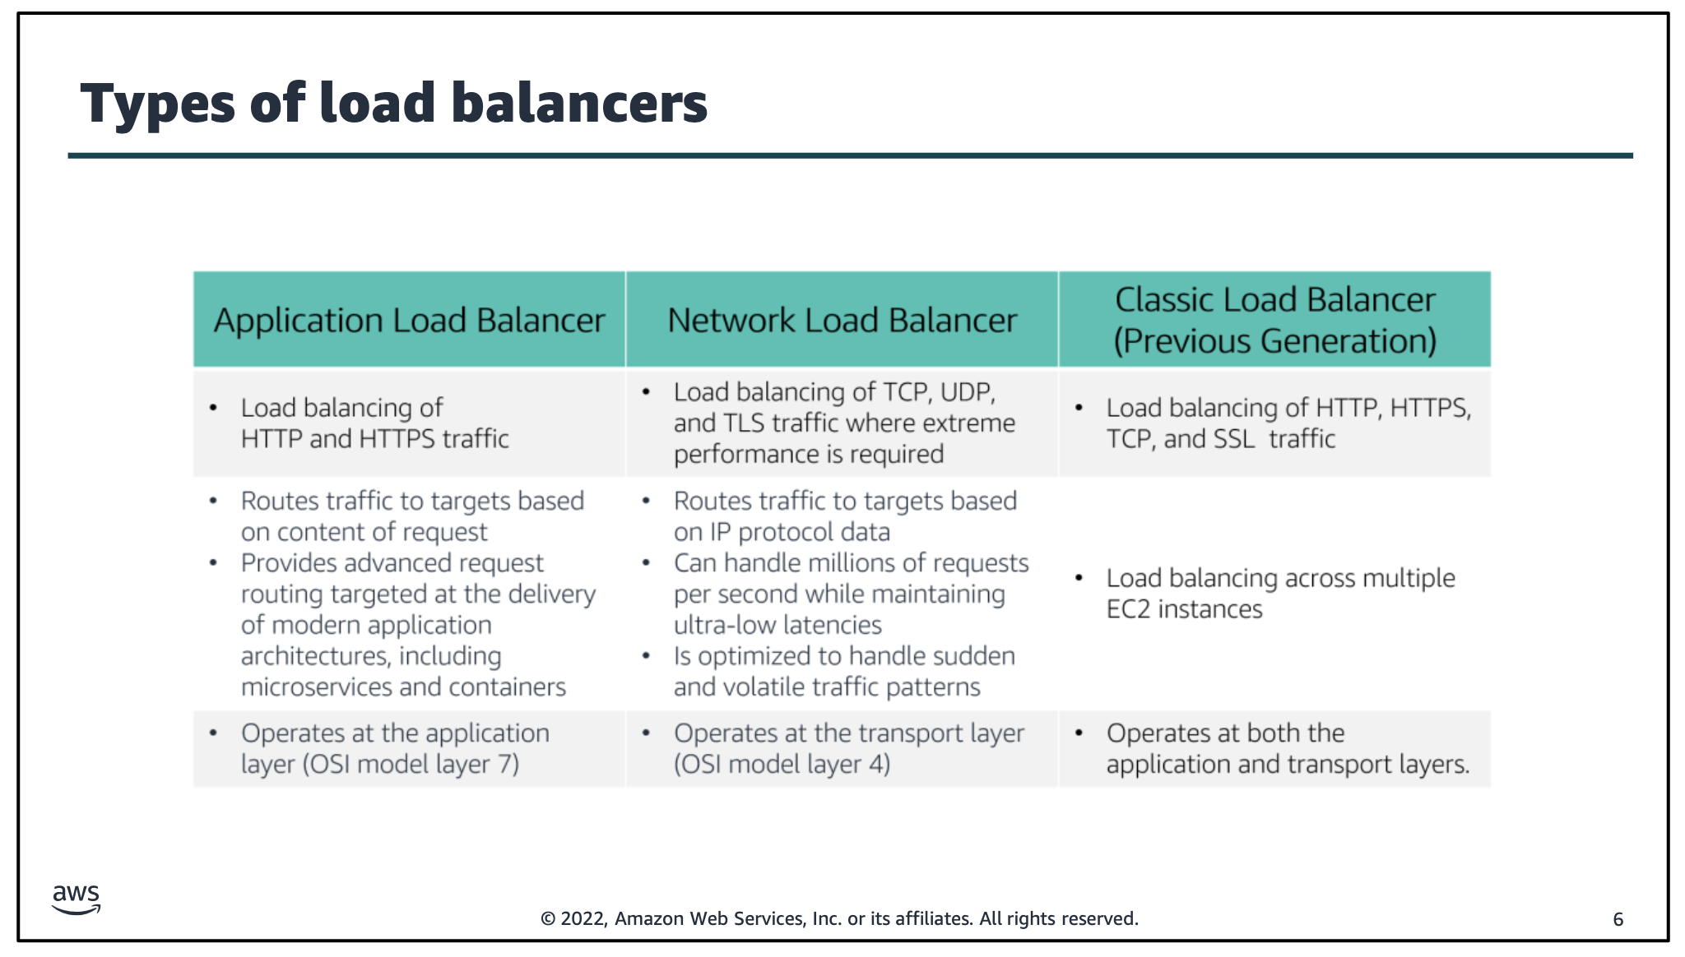
Notes:
Elastic Load Balancing is available in three types:•An Application Load Balanceroperates at the application level (Open Systems Interconnection, or OSI, model layer 7). It routes traffic to targets—Amazon Elastic Compute Cloud (Amazon EC2) instances, containers, Internet Protocol (IP) addresses, and Lambda functions—based on the content of the request. It is ideal for advanced load balancing of Hypertext Transfer Protocol (HTTP) and Secure HTTP (HTTPS) traffic. An Application Load Balancer provides advanced request routing that is targeted at delivery of modern application architectures, including microservices and container-based applications. An Application Load Balancer simplifies and improves the security of your application by ensuring that the latest Secure Sockets Layer/Transport Layer Security (SSL/TLS) ciphers and protocols are used at all times.•A Network Load Balanceroperates at the network transport level (OSImodel layer 4), routing connections to targets—EC2instances, microservices, and containers—based on IP protocol data. It works well for load balancing both Transmission Control Protocol (TCP) and User Datagram Protocol (UDP) traffic. A Network Load Balancer is capable of handling millions of requests per second while maintaining ultra-low latencies. A Network Load Balancer is optimized to handle sudden and volatile network traffic patterns. •A Classic Load Balancerprovides basic load balancing across multiple EC2instances, and it operates at both the application level and network transport level. A Classic Load Balancer supports the load balancing of applications that use HTTP, HTTPS, TCP, and SSL. The Classic Load Balancer is an older implementation. When possible, AWS recommends that you use a dedicated Application Load Balancer or Network Load Balancer. AWS Training and Certification Module 10: Auto Scaling and Monitoring © 2022 Amazon Web Services, Inc. or its affiliates. All rights reserved. 9

Slide 4
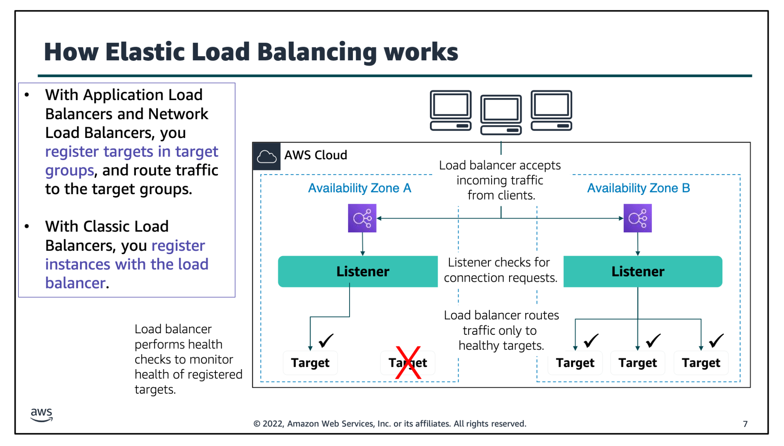
Notes:
A load balancer accepts incoming traffic from clients and routes requests to its registered targets (such as EC2 instances) in one or more Availability Zones. You configure your load balancer to accept incoming traffic by specifying one or more listeners. A listener is a process that checks for connection requests. It is configured with a protocol and port number for connections from clients to the load balancer. Similarly, it is configured with a protocol and port number for connections from the load balancer to the targets. You can also configure your load balancer to perform health checks, which are used to monitor the health of the registered targets so that the load balancer only sends requests to the healthy instances. When the load balancer detects an unhealthy target, it stops routing traffic to that target. It then resumes routing traffic to that target when it detects that the target is healthy again. There is a key difference in how the load balancer types are configured. With Application Load Balancers and Network Load Balancers, you register targets in target groups, and route traffic to the target groups. With Classic Load Balancers, you register instances with the load balancer.

Slide 5
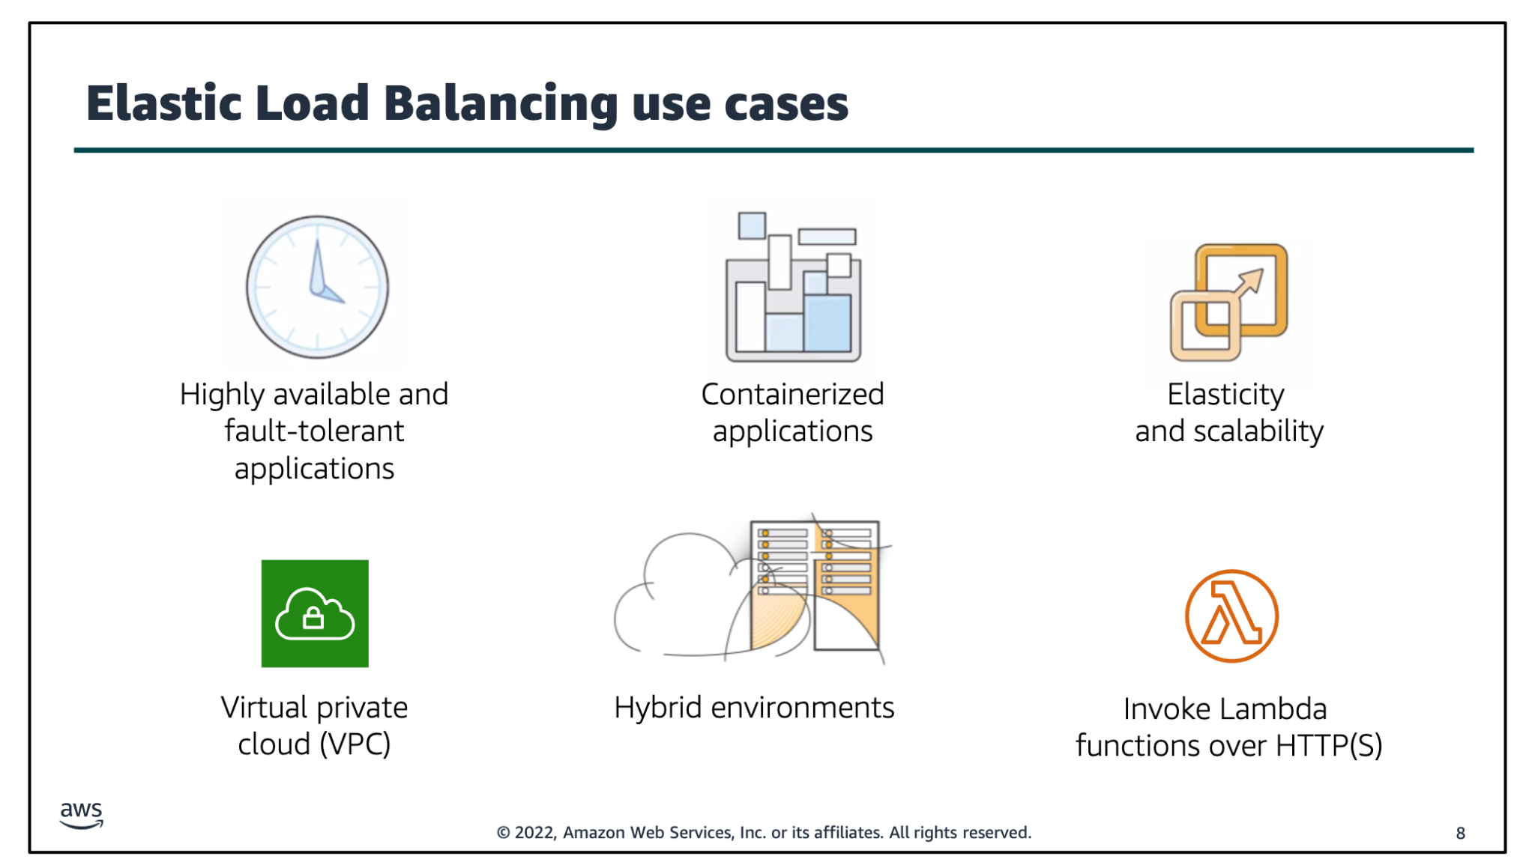
Notes:
© 2022, Amazon Web Services, Inc. or its affiliates. All rights reserved.8Elastic Load Balancing use casesHighly available andfault-tolerantapplicationsContainerizedapplicationsElasticity and scalabilityVirtual privatecloud (VPC)Hybrid environmentsInvoke Lambda functions over HTTP(S)There are many reasons to use a load balancer: •Achieve high availability and better fault tolerance for your applications–Elastic Load Balancing balances traffic across healthy targets in multiple Availability Zones. If one or more of your targets in a single Availability Zone are unhealthy, Elastic Load Balancing will route traffic to healthy targets in other Availability Zones. After the targets return to a healthy state, load balancing will automatically resume traffic to them. •Automatically load balance your containerized applications–With enhanced container support for Elastic Load Balancing, you can now load balance across multiple ports on the same EC2 instance. You can also take advantage of deep integration with Amazon Elastic Container Service (Amazon ECS), which provides a fully-managed container offering. You only need to register a service with a load balancer, and Amazon ECS transparently manages the registration and de-registration of Docker containers. The load balancer automatically detects the port and dynamically reconfigures itself.•Automatically scale your applications–Elastic Load Balancing works with Amazon CloudWatch and Amazon EC2 Auto Scaling to help you scale your applications to the demands of your customers. Amazon CloudWatch alarms can trigger auto scaling for your EC2 instance fleet when the latency of any one of your EC2 instances exceeds a preconfigured threshold. Amazon EC2 Auto Scaling then provisions new instances and your applications will be ready to serve the next customer request. The load balancer will register the EC2 instance and direct traffic to it as needed.
Use Elastic Load Balancing in your virtual private cloud (VPC)–You can use Elastic Load Balancing to create a public entry point into your VPC, or to route request traffic between tiers of your application within your VPC. You can assign security groups to your load balancer to control which ports are open to a list of allowed sources. Because Elastic Load Balancing works with your VPC, all your existing network access control lists (network ACLs) and routing tables continue to provide additional network controls. When you create a load balancer in your VPC, you can specify whether the load balancer is public (default) or internal. If you select internal, you do not need to have an internet gateway to reach the load balancer, and the private IP addresses of the load balancer will be used in the load balancer’s Domain Name System (DNS) record.•Enablehybrid load balancing–Elastic Load Balancing enables you to load balance across AWS and on-premises resources by using the same load balancer. For example, if you must distribute application traffic across both AWS and on-premises resources, you can register all the resources to the same target group and associate the target group with a load balancer. Alternatively, you can use DNS-based weighted load balancing across AWS and on-premises resourcesbyusing two load balancers, with one load balancer for AWS and other load balancer for on-premises resources. You can also use hybrid load balancing to benefit separate applications where one application is in a VPC and the other application is in an on-premises location. Put the VPC targets in one target group and the on-premises targets in another target group, and then use content-based routing to route traffic to each target group.•Invoking Lambda functions over HTTP(S)–Elastic Load Balancing supports invoking Lambda functions to serve HTTP(S) requests. This enables users to access serverless applications from any HTTP client, including web browsers. You can register Lambda functions as targets and use the support for content-based routing rules in Application Load Balancers to route requests to different Lambda functions. You can use an Application Load Balancer as a common HTTP endpoint for applications that use servers and serverless computing. You can build an entire website by using Lambda functions, or combine EC2 instances, containers, on-premises servers, and Lambda functions to build applications.8AWS Training and Certification Module 10: Auto Scaling and Monitoring © 2022 Amazon Web Services, Inc. or its affiliates. All rights reserved. 13

Slide 6
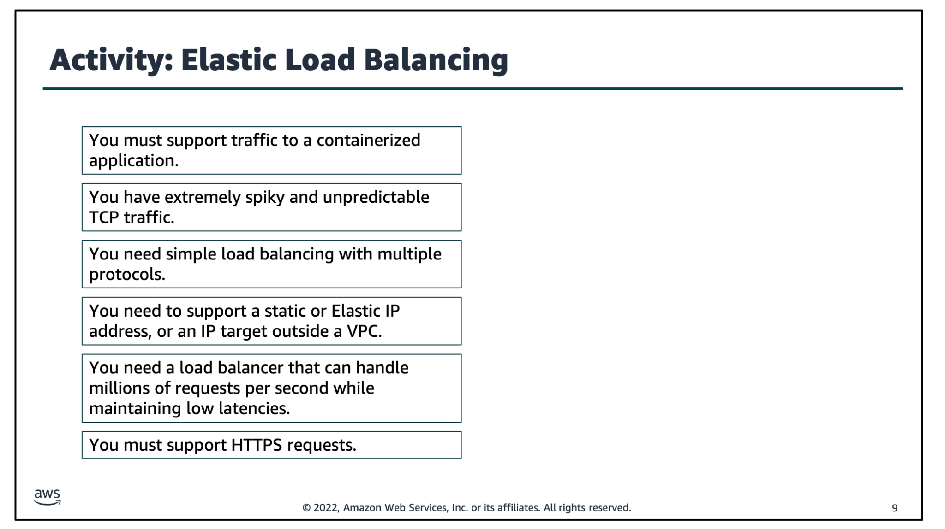

Slide 7
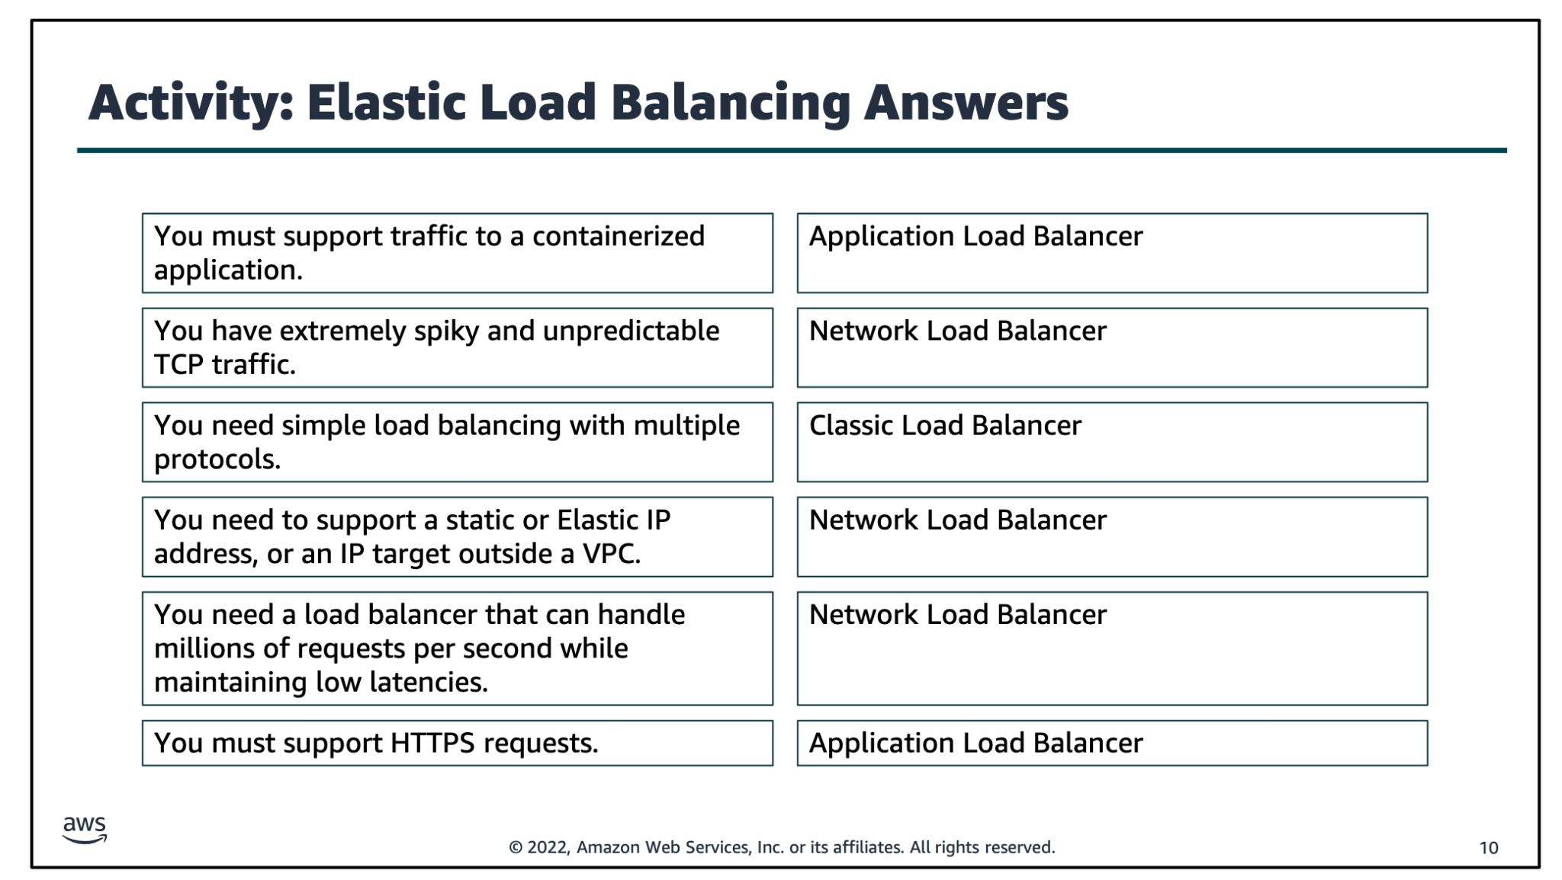

Slide 8
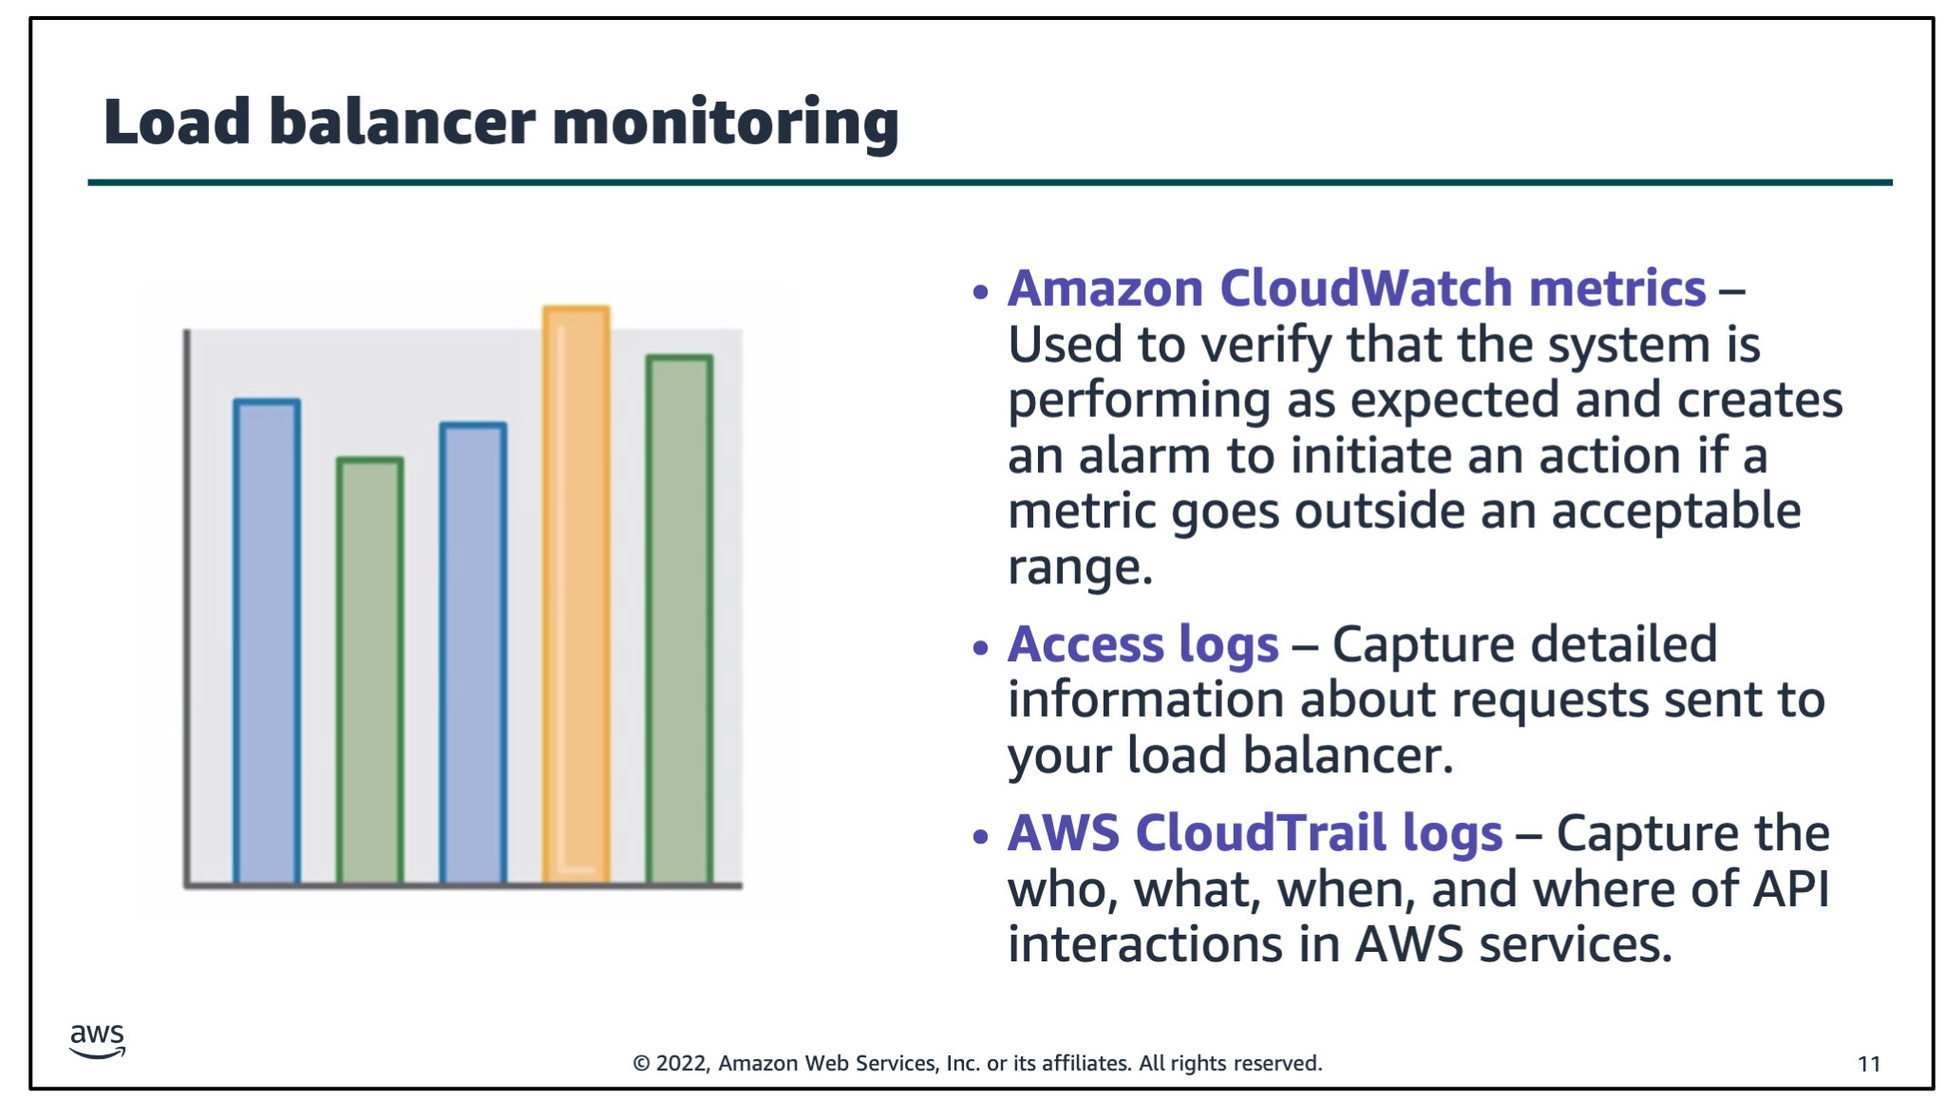
Notes:
You can use the following features to monitor your load balancers, analyze traffic patterns, and troubleshoot issues with your load balancers and targets:•Amazon CloudWatch metrics–Elastic Load Balancing publishes data points to Amazon CloudWatch for your load balancers and your targets. CloudWatch enables you to retrieve statistics about those data points as an ordered set of timeseries data, known as metrics. You can use metrics to verify that your system is performing as expected. For example, you can create a CloudWatch alarm to monitor a specified metric and initiate an action (such as sending a notification to an email address) if the metric goes outside what you consider an acceptable range. •Access logs–You can use access logs to capture detailed information about the requests that were made to your load balancer and store them as log files in Amazon Simple Storage Service (Amazon S3). You can use these access logs to analyze traffic patterns and to troubleshoot issues with your targets or backend applications.•AWS CloudTrail logs–You can use AWS CloudTrail to capture detailed information about the calls thatwere made to the Elastic Load Balancing application programming interface (API) and store them as log files in Amazon S3. You can use these CloudTrail logs to determine who made the call, what calls were made, when the call was made, the source IP address of where the call came from, and so on.

